Slide 1

SRM INSTITUTE OF SCIENCE AND TECHNOLOGY Ramapuram , Chennai – 600 089 DEPARTMENT OF COMPUTER SCIENCE AND ENGINEERING
21CSC305P/ MACHINE LEARNING
Toxic Comment Blurring System
BATCH NUMBER :3
Team Members | Supervisor
VILASNI M [RA2311003020003] MOHAMED SHAKEEL M S [RA2311003020012] HARIHARAN S [RA2311003020012] TAMIZHSELVAN A [RA23110003020022] | Dr. Adlene Ebenezer P, Assistant Professor, Dept. of CSE, SRM IST, Ramapuram

Slide 2
ABSTRACT
The system uses DistilBERT to detect and classify toxic
comments.
Identified toxic comments are automatically blurred for user
protection.
A toggle button allows users to unblur and
view the comment if they wish.
Built using Flask, Chrome Extension, and Ngrok for real-time
operation.
Promotes a safe online space while preserving freedom of
expression.

Slide 3
Scope and Motivation
Scope:
Detects toxic comments on YouTube using DistilBERT.
Blurs harmful text with an Unblur toggle for user choice.
Uses Flask, Chrome Extension, and Ngrok for real-time working.
Focused on English comments, expandable to other platforms.
Promotes safe, user-controlled online interaction.
Motivation:
Rise in toxic comments affecting user’s mental health.
Existing systems delete or misclassify comments.
Need for a balanced solution that ensures safety and freedom.

Slide 4
Introduction
Toxic Language Detection & Content Filtering
Online platforms like YouTube, Instagram, and Twitter face rising toxic and abusive comments.
Our system automatically detects and blurs offensive content in real-time.
Ensures user safety while maintaining context, promoting a safer and inclusive online environment.

Slide 5
Literature Survey
S.No. | Title of the Paper | Year | Methodology Used | Inferences
1 | Hydrangea@DravidianLangTech2025: Abusive language Identification from Tamil and Malayalam Text using Transformer Models | 2025 | Fine-tune transformer models (BERT, XLM-RoBERTa, DistilBERT) on YouTube comments in Tamil & Malayalam. | XLM-RoBERTa gave the best F1 in both languages. DistilBERT worked well for Tamil but dropped significantly for Malayalam (low-resource setting). Shows that multilingual pre-training helps

Slide 6
Literature Survey
S.No. | Title of the Paper | Year | Methodology Used | Inferences
2 | A Text-to-Text Model for Multilingual Offensive Language Identification | 2023 | Use text-to-text transformer models (T5, mT5) trained on multiple offensive language datasets (SOLID, CCTK), combining datasets for multilingual offensive/hate/offensive content detection | The T5-based models outperform many encoder-only transformers. The multilingual version (mT5) performs very well across several languages, showing that multilingual models generalize better.

Slide 7
Literature Survey
S.No. | Title of the Paper | Year | Methodology Used | Inferences
3 | BanglaHateBERT: BERT for Abusive Language Detection in Bengali | 2022 | Retrain (fine tune) a BERT variant for Bengali using a large corpus of Bengali hateful/abusive posts, balanced hate-speech annotations, etc. Comparison vs generic BERT. | BanglaHateBERT outperforms generic pre-trained BERT in Bengali abusive detection tasks. Important example of how retraining on language-specific abusive content improves performance in non-English or low-resource settings.

Slide 8
Literature Survey
S.No. | Title of the Paper | Year | Methodology Used | Inferences
4 | Efficient Toxic Content Detection by Bootstrapping and Distilling Large Language Models | 2023 | Bootstraps large language models (LLMs) and distills them into smaller student models; uses a prompting method called Decision-Tree-of-Thought (DToT) and fine-tunes student models with rationales extracted from LLMs. | The distilled student models are much smaller and faster but still maintain strong accuracy and cross-dataset performance. Good example for how to make a lightweight model for toxicity detection.

Slide 9
Literature Survey
S.No. | Title of the Paper | Year | Methodology Used | Inferences
5 | CNLP-NITS-PP at GenAI Detection Task 3: Cross-Domain Machine-Generated Text Detection Using DistilBERT Techniques | 2025 | Fine-tuned DistilBERT for the task of detecting machine-generated text; addresses adversarial strategies (paraphrasing, misspellings, etc.) with cross-domain data training. | Shows DistilBERT is capable of performing well even when text is adversarial or from different domains. Useful for your project if comments also come from diverse sources.

Slide 10
Objective
Detect toxic and abusive comments automatically in online platforms.
Blur or hide offensive content to improve user experience and digital safety.
Provide a real-time, privacy-preserving solution without sending user data to external servers.
Create a lightweight, efficient system that can be integrated with any website or social media platform.

Slide 11
Problem Statement
Online platforms face a rise in toxic and abusive comments.
Such content causes emotional harm and discourages user participation.
Manual moderation is slow, costly, and mentally exhausting.
Keyword filters fail to understand context or sarcasm.
Existing systems often over-censor or miss subtle toxicity.
There is a need for an intelligent, real-time, and user-friendly moderation solution.

Slide 12
Proposed Work
Develop a Toxic Comment Blurring System using DistilBERT for detection.
Extract YouTube comments through a Chrome Extension.
Send comments to a Flask backend via Ngrok for analysis.
Preprocess text and classify comments as toxic or non-toxic.
Blur toxic comments automatically in the browser interface.
Add an “Unblur” toggle button for user-controlled visibility.
Ensure real-time processing, user safety, and freedom of choice.

Slide 13
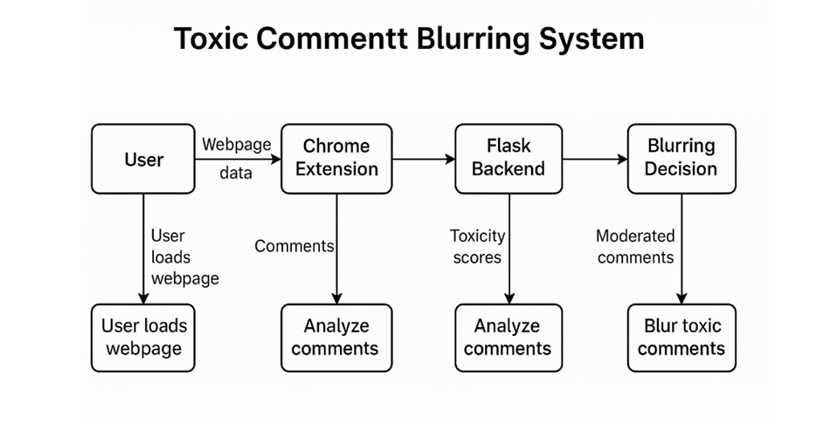
Architecture Diagram

Slide 14
Module Description
Module 1: Data Collection
Description:
Gather text data containing toxic, abusive, or offensive comments from publicly available datasets.
Prepare training and testing data in CSV format for the model.
Ensure data is cleaned, labeled, and representative of different types of abusive language.

Slide 15
Module Description
Module 2: Model Training
Description:
Train a machine learning model using DistilBERT for toxic comment detection.
Use tokenization and self-attention mechanisms to understand the context and meaning of text.
Optimize the model for high accuracy, precision, and recall on detecting abusive comments.

Slide 16
Module Description
Module 3: Backend API
Description:
Develop a Flask API to serve the trained model.
Accept text input from front-end or extension and return predictions in real-time.
Enable local processing to maintain privacy and efficiency.

Slide 17
Module Description
Module 4: Browser Extension
Description:
Create a Chrome/Edge extension to integrate the detection system with websites.
Automatically scan comments on a page and blur abusive content.
Provide a toggle button to unblur content if needed.

Slide 18
Module Description
Module 5: Real-time Comment Filtering
Description:
Combine the trained model, backend API, and extension for live usage.
Ensure the system works seamlessly on platforms like YouTube or Instagram.
Provide users with a safer browsing experience without disrupting normal interaction

Slide 19
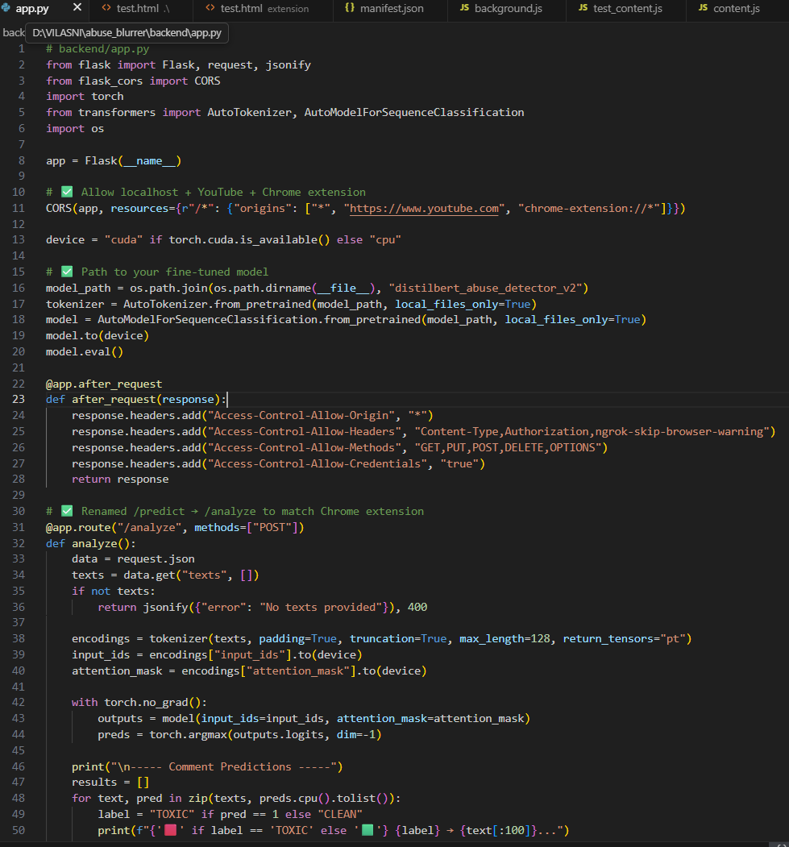
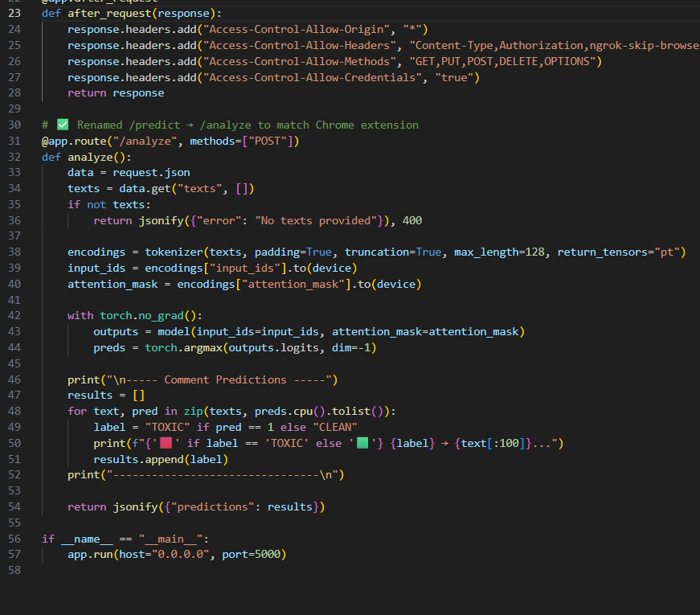
Implementation

Slide 20
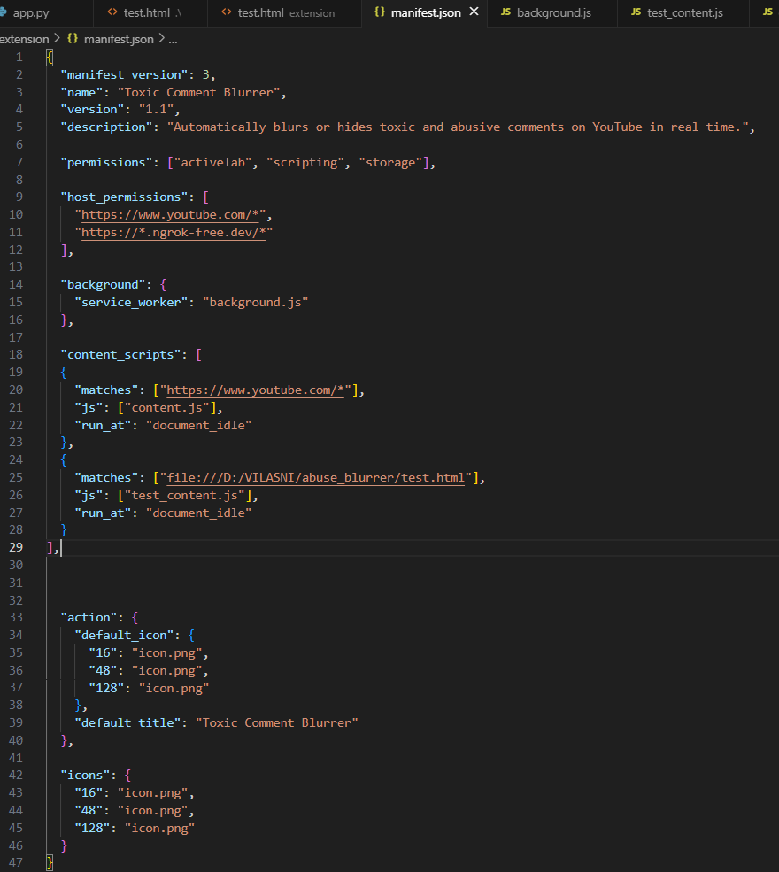
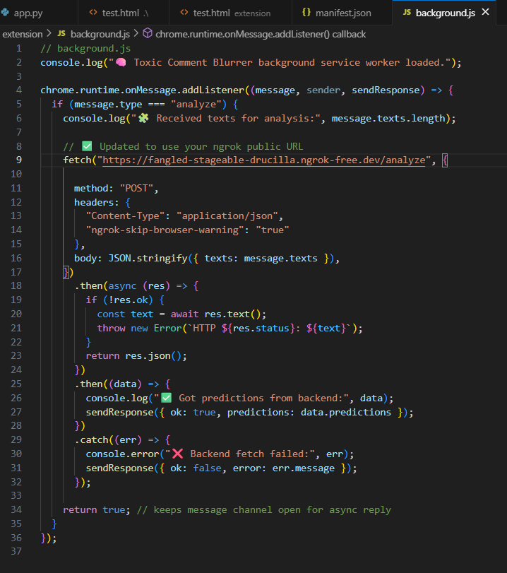
Implementation

Slide 21
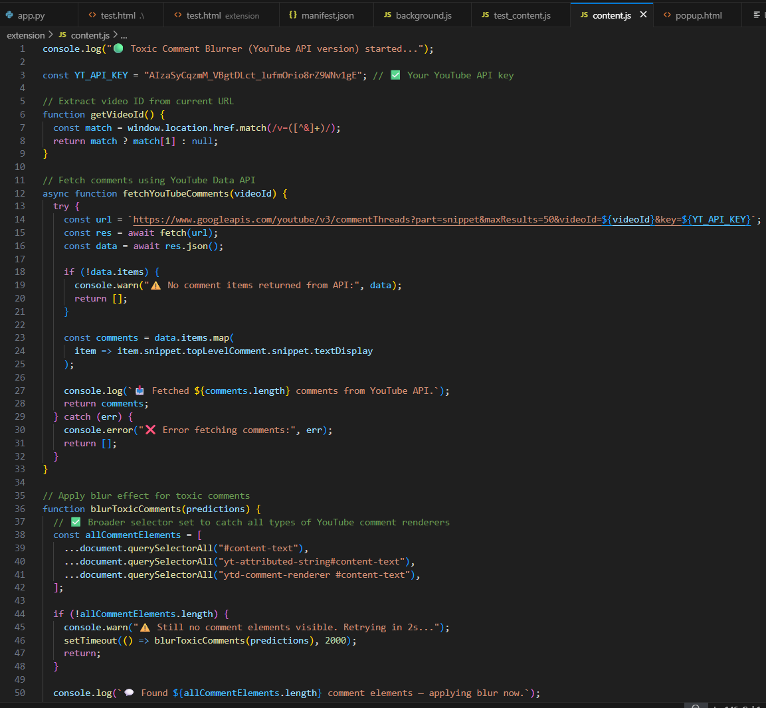
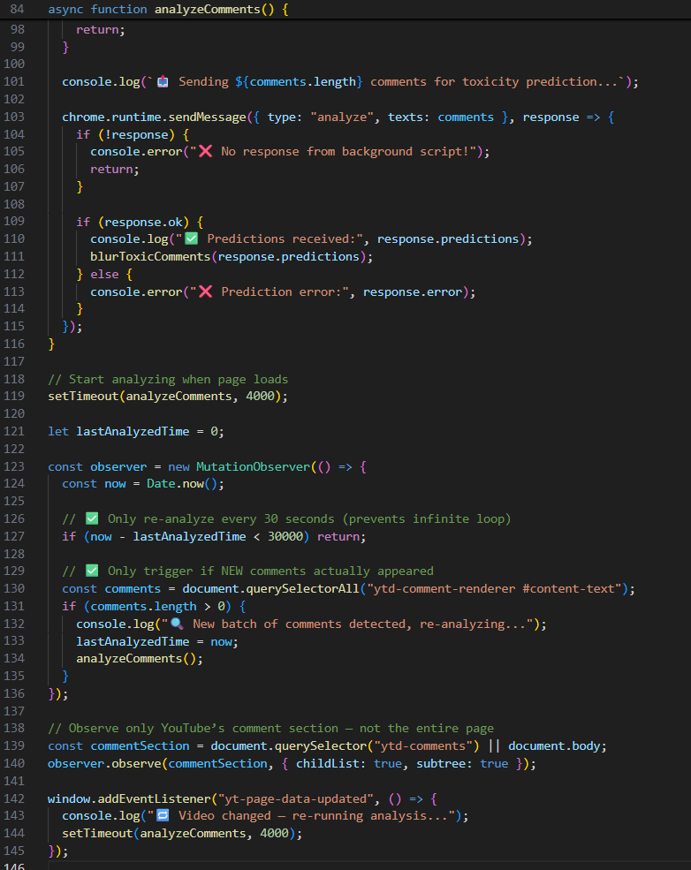
Implementation

Slide 22
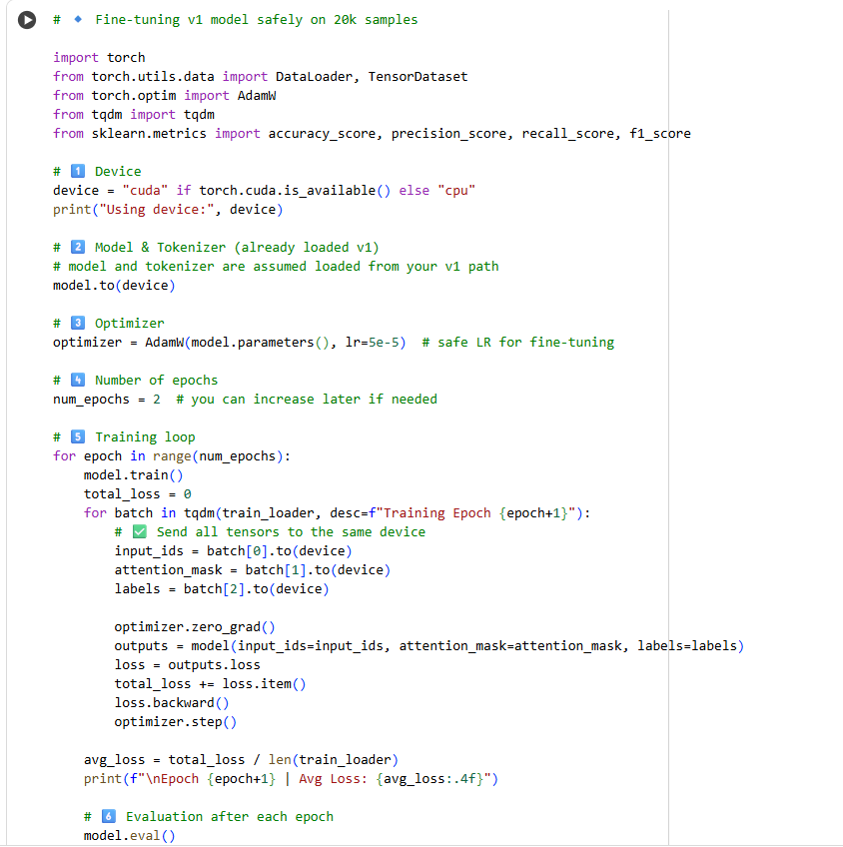
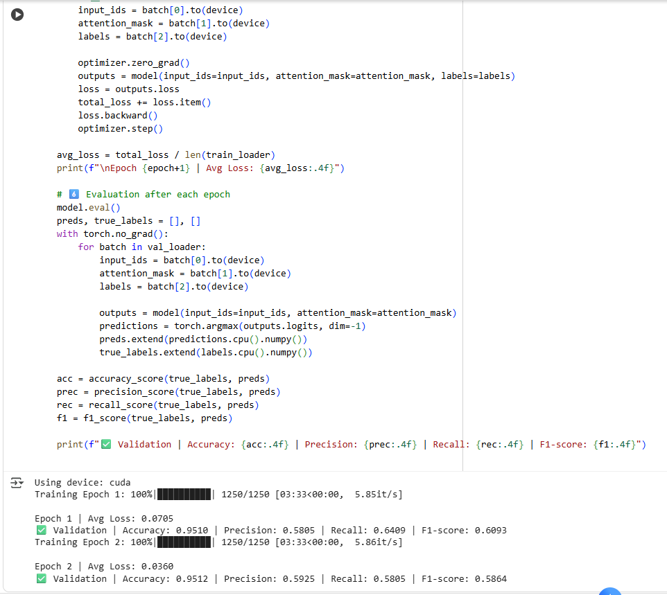
Implementation

Slide 23
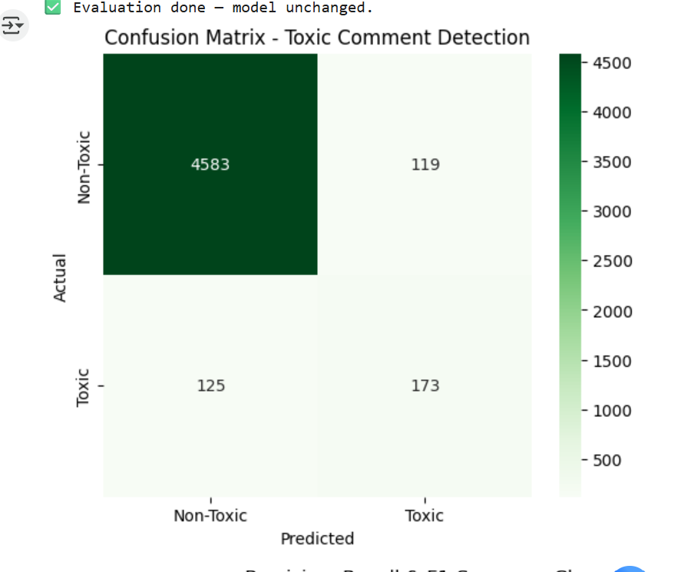
Result

Slide 24
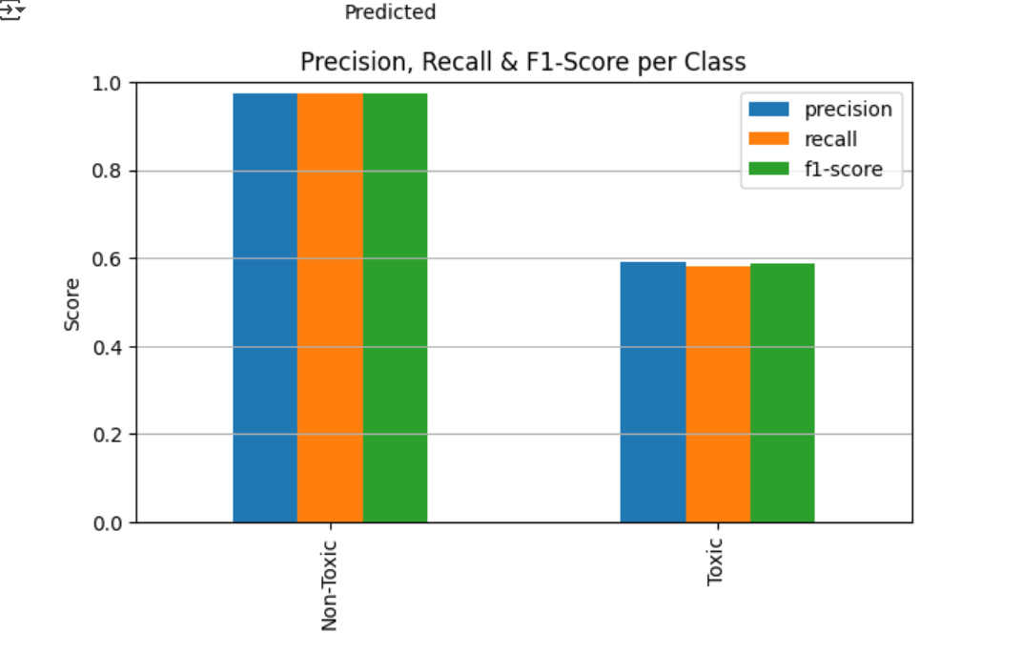
Result

Slide 25
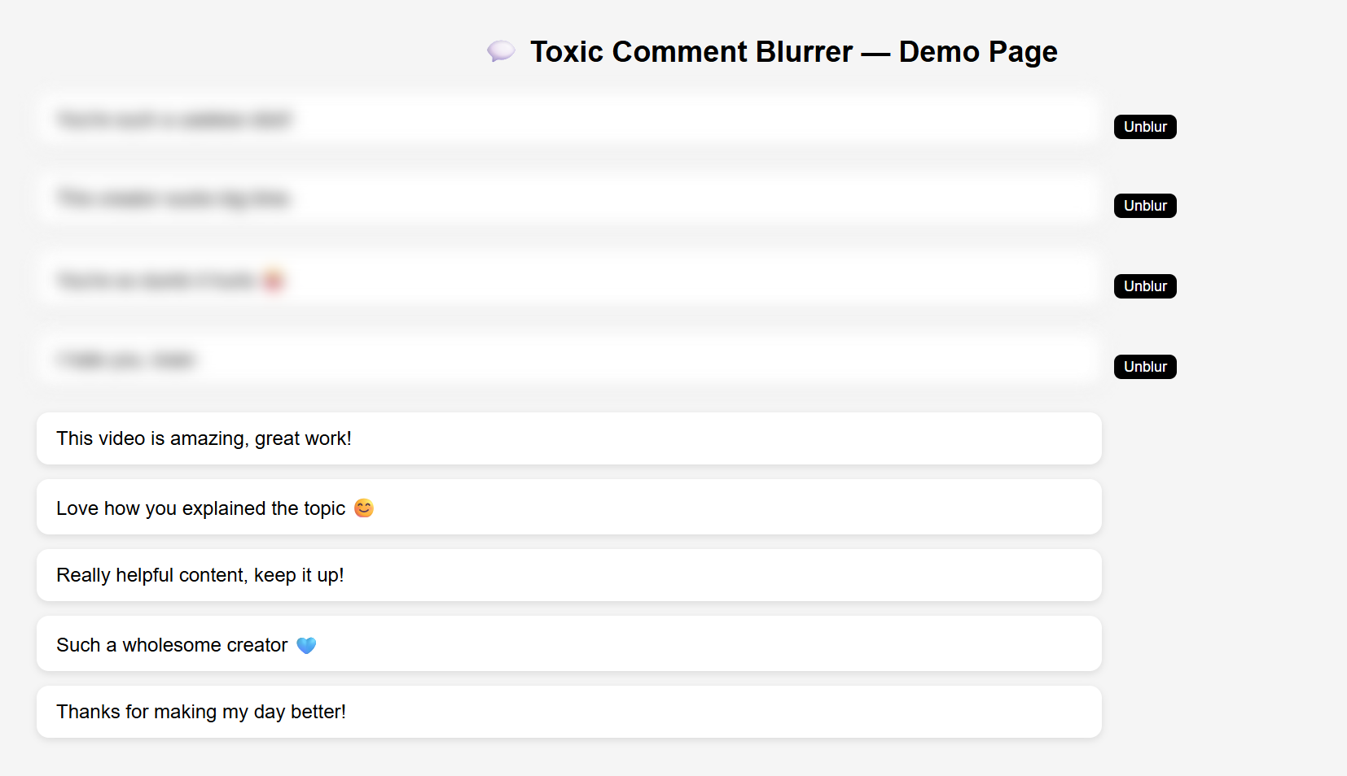
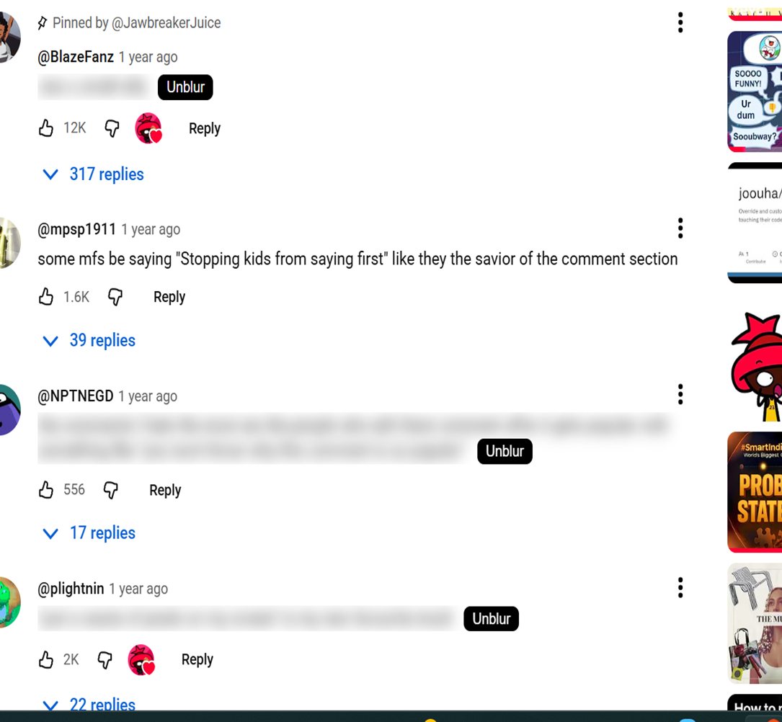
Result

Slide 26
Conclusion
The system detects and blurs toxic comments using the DistilBERT algorithm.
Ensures user safety while maintaining freedom of expression through an Unblur option.
Integrates Flask, Ngrok, and a Chrome Extension for real-time operation.
Promotes a positive online environment by reducing exposure to harmful content.
Demonstrates how AI can enhance digital well-being and create safer online spaces.

Slide 27
Future Work
Train the model on larger, multilingual datasets for better accuracy.
Enable real-time adaptive learning using user feedback.
Add emotion and sentiment analysis for deeper understanding.
Expand into a cross-platform API for wider integration.
Provide customizable settings for toxicity sensitivity and blur level.
Implement edge AI for faster, private, real-time processing.

Slide 28
References
1. Perspective API. (2024). Using Machine Learning to Identify Toxic Comments. Google Jigsaw. Available at: https://www.perspectiveapi.com
2. Davidson, T., Warmsley, D., Macy, M., & Weber, I. (2017). Automated Hate Speech Detection and the Problem of Offensive Language. Proceedings of ICWSM 2017, AAAI Publications.
3. Zhang, Z., Robinson, D., & Tepper, J. (2018). Detecting Hate Speech on Twitter Using a Convolution–GRU Based Deep Neural Network. In Proceedings of the European Semantic Web Conference (ESWC 2018).
4. Vidgen, B., & Derczynski, L. (2020). Directions in Abusive Language Training Data, a Systematic Review: Garbage In, Garbage Out. PLOS ONE, 15(12): e0243300.
5. Fortuna, P., & Nunes, S. (2018). A Survey on Automatic Detection of Hate Speech in Text. ACM Computing Surveys, 51(4), 1–30. DOI: 10.1145/3232676.

Slide 29
References
6. Dos Santos, C., & Gatti, M. (2014). Deep Convolutional Neural Networks for Sentiment Analysis of Short Texts. Proceedings of COLING 2014: Technical Papers.
7. GitHub. (2024). Toxic Comment Classification Challenge Dataset. Available at: https://github.com/ (Accessed: October 2025).
8. Srivastava, S., & Khare, V. (2022). Detection of Toxic Comments Using NLP and Deep Learning. International Journal of Computer Applications, Vol. 184(43), pp. 22–27.
9. Chen, Y., & Chen, C. (2023). Real-Time Browser Extensions for Content Moderation Using Flask and Chrome APIs. Journal of Web Engineering and Technology, 21(3), 45–58.
10. Pitsilis, G., Ramampiaro, H., & Langseth, H. (2018). Effective Hate-Speech Detection in Twitter Data Using Recurrent Neural Networks. Applied Intelligence, 48, 4730–4742. DOI: 10.1007/s10489-018-1242-y.

